Slide 2
Developing Cross Platform Apps using Cognitive Services API
Khiem-Kim Ho Xuan

Slide 3
Overview
Introduction
Apis and cool stuff
How to register
Live code samples and demo
The cons

Slide 4



Introduction
(formerly Project Oxford) are a set of APIs, SDKs and services available to developers to make their applications more intelligent, engaging and discoverable
Enables natural and contextual interaction that augments user experiences
Uses Machine-based AI. Give your apps a human side

Slide 5
Apis and cool stuffs
In total there are 22 APIs available in Cognitive Services now
Be cool! Publish your own app:
https://www.microsoft.com/cognitive-services/en-us/applications
Extend Cognitive Services with Bots framework!
Get Started now!
https://www.microsoft.com/cognitive-services/en-us/computer-vision-api/documentation/getstarted/getstartedvisionapiforwindows

Slide 6
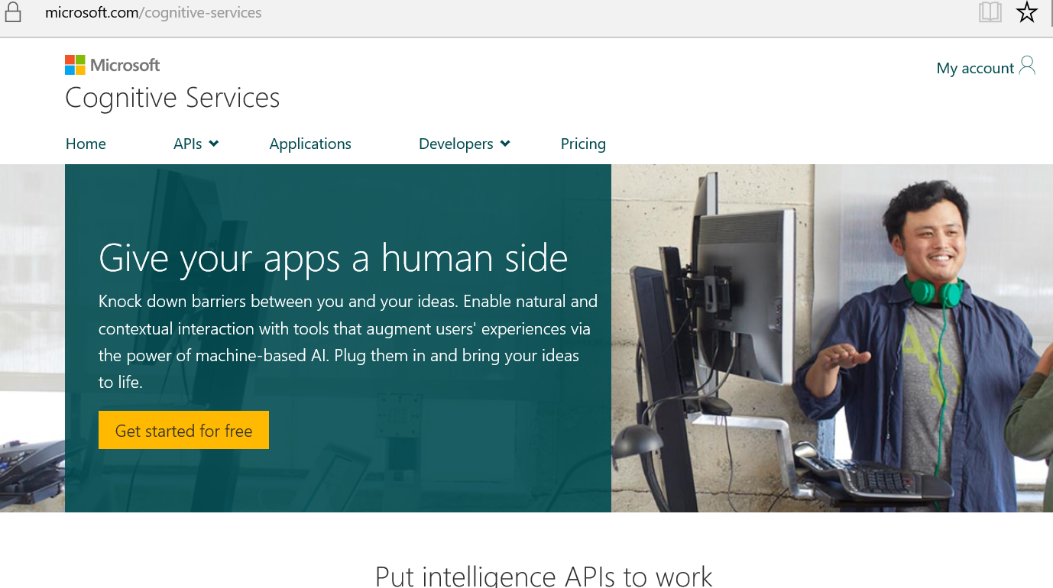
How to register
Go to: https://microsoft.com/cognitive-services
Have a microsoft account
Enable the API’s you want
Ugh use Microsoft IE or Edge.

Slide 7
Code sample
private VisionServiceClient visionServiceClient = new VisionServiceClient("API KEY");
private async Task<AnalysisResult> UploadAndDescribeImage(MediaFile file)
{
AnalysisResult analysisResult = await visionServiceClient.DescribeAsync(file.GetStream(), 3);
return analysisResult;
}

Slide 8
Code Sample
Not supporting all libraries.
Create a HTTPClient and do it based on httpwebservice call than a library.
PCL support:
Computer Vision API
Face Detection API
Emotion API
Linquistics API
Speaker Recognizition API

Slide 9
Code sample
curl -v -X POST "https://api.projectoxford.ai/vision/v1.0/analyze?visualFeatures=Categories&details={string}" -H "Content-Type: application/json" -H "Ocp-Apim-Subscription-Key: {subscription key}" --data-ascii "{body}"

Slide 10
Code sample
Result:
{
"categories":[
{
"name":"abstract_",
"score":0.00390625
},
….
{
"name":"people_",
"score":0.83984375,
…..
}

Slide 11
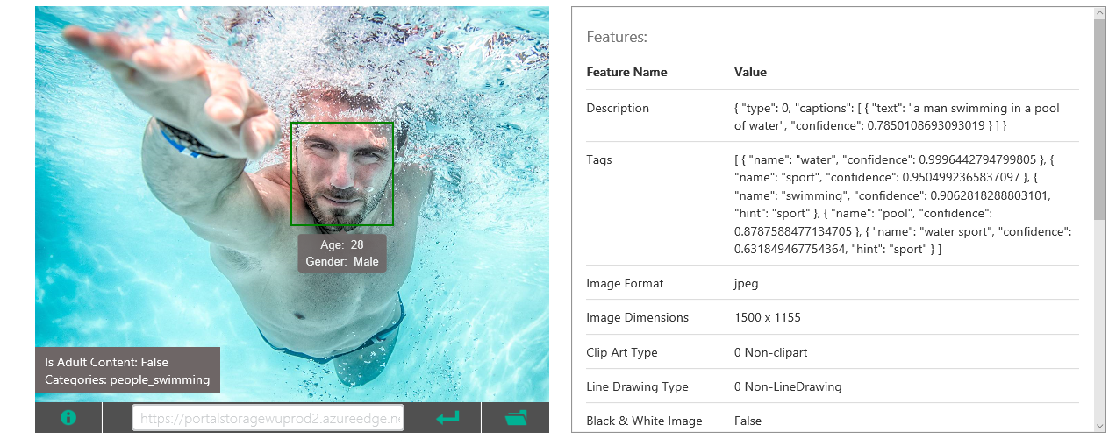
Image recognition

Slide 12
Speaker recognizition
Can be used for authentication recognizition
curl -v -X POST "https://api.projectoxford.ai/spid/v1.0/identificationProfiles/{identificationProfileId}/enroll" -H "Content-Type: multipart/form-data" -H "Ocp-Apim-Subscription-Key: {subscription key}" --data-ascii "{body}"

Slide 13
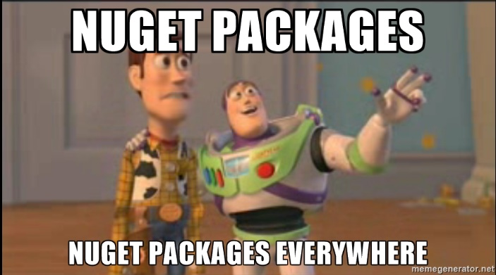




Live code samples and demo

Slide 14
The cons
Pricing!? (free from 5000- 30000 api calls per month)
Microsoft IE or Edge to login?
Still in preview
PCL limited support ☹ (most cognitive services are not yet available for Xamarin.Forms, must create own calls)
API key per API?!

Slide 15
Thank you!

